Slide 1
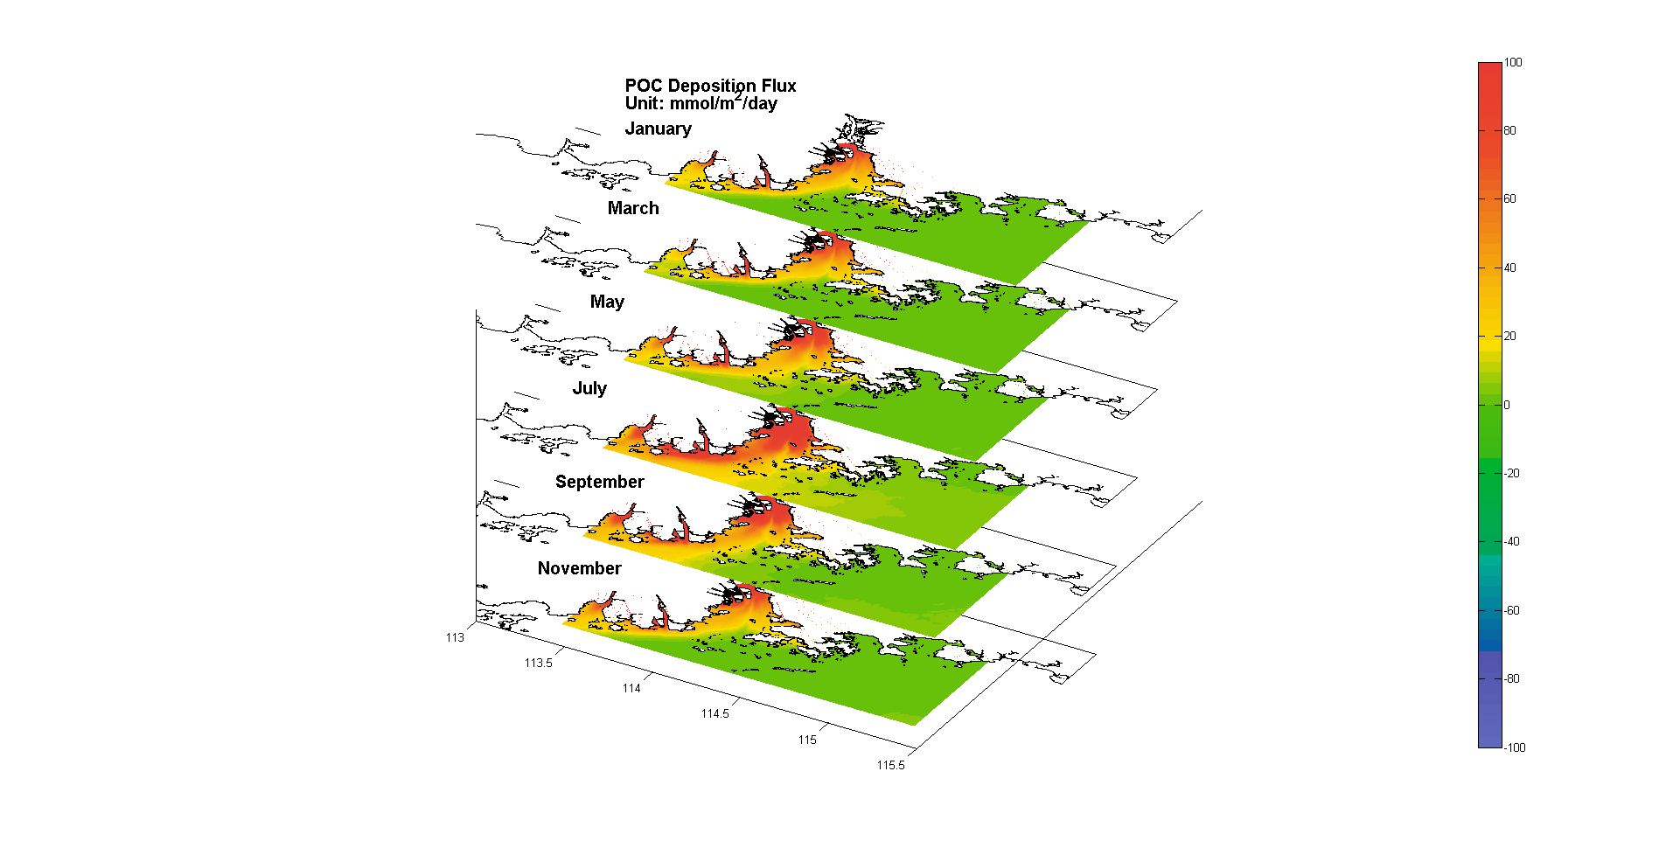
Notes:
Figure 9. (a) Monthly averaged POC deposition flux; (b) Monthly averaged DIC exchange Flux; (c) Monthly averaged net carbon flux (carbon Export) from overlying water to sediment; (d) Monthly averaged POC burial flux in sediment.

Slide 2
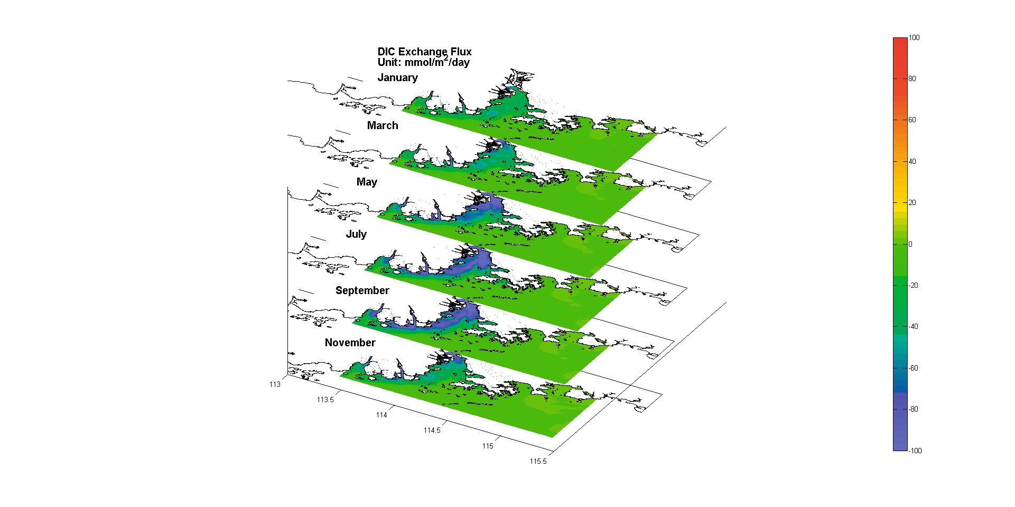
Notes:
Figure 9. (a) Monthly averaged POC deposition flux; (b) Monthly averaged DIC exchange Flux; (c) Monthly averaged net carbon flux (carbon Export) from overlying water to sediment; (d) Monthly averaged POC burial flux in sediment.

Slide 3
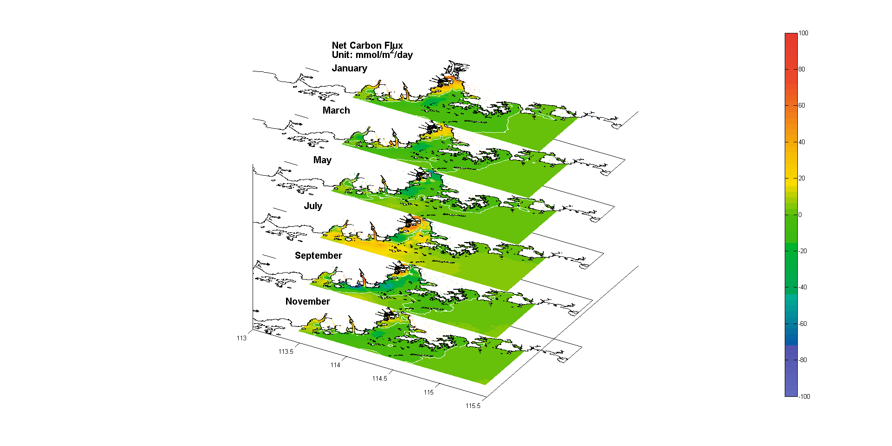
Notes:
Figure 9. (a) Monthly averaged POC deposition flux; (b) Monthly averaged DIC exchange Flux; (c) Monthly averaged net carbon flux (carbon Export) from overlying water to sediment; (d) Monthly averaged POC burial flux in sediment.

Slide 4
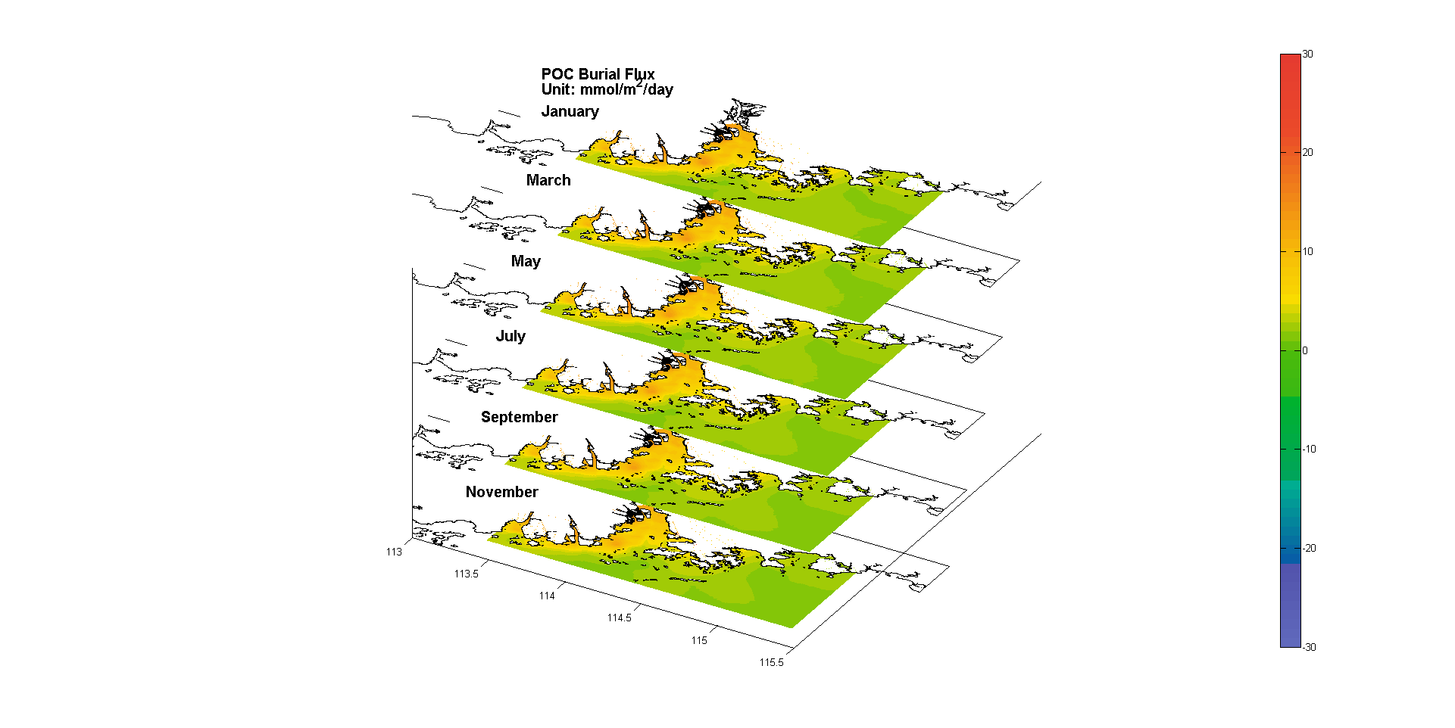
Notes:
Figure 9. (a) Monthly averaged POC deposition flux; (b) Monthly averaged DIC exchange Flux; (c) Monthly averaged net carbon flux (carbon Export) from overlying water to sediment; (d) Monthly averaged POC burial flux in sediment.

Slide 5
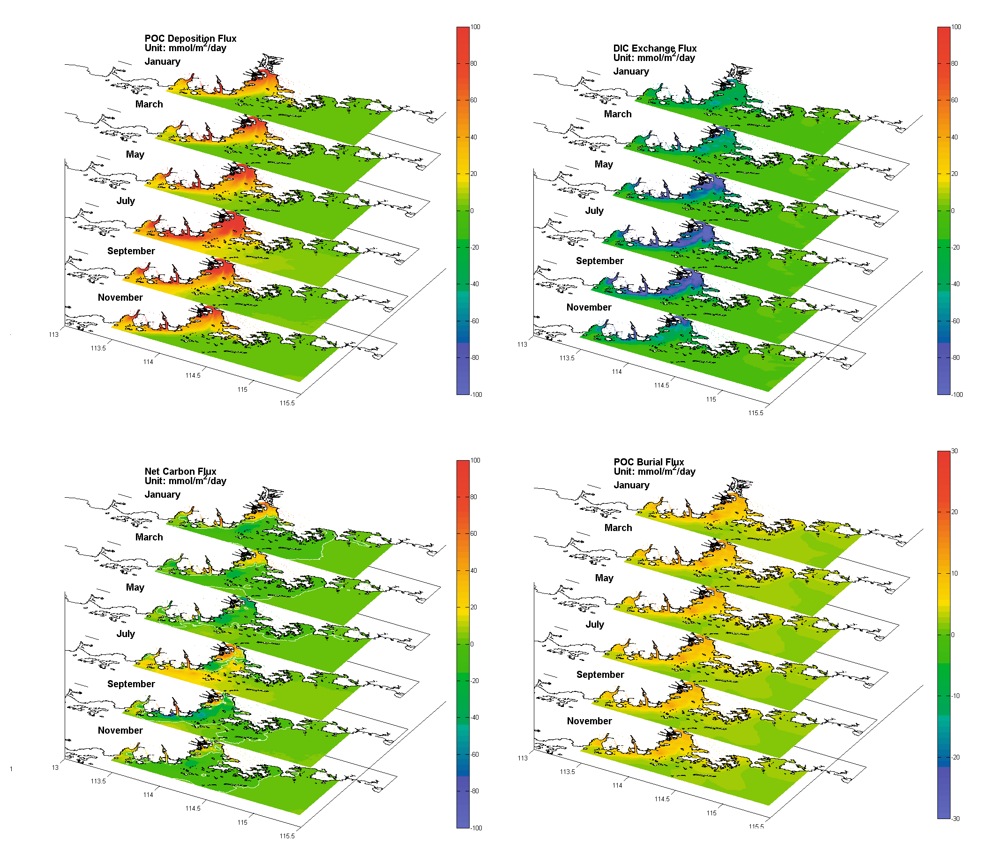
Notes:
Figure 9. (a) Monthly averaged POC deposition flux; (b) Monthly averaged DIC exchange Flux; (c) Monthly averaged net carbon flux (carbon Export) from overlying water to sediment; (d) Monthly averaged POC burial flux in sediment.

